Slide 1
S2-19_DSECLZC415 APPLICATIONS OF DATA MINING FRAUD DETECTION RECOMMENDATION SYSTEM & SENTIMENT ANALYSIS - COMBINED CONTACT SESSION 16
SEPTEMBER 5 2020 – Dr.D.VENKATA SUBRAMANIAN

Slide 2
APPLICATIONS OF DATA MINING
Future Healthcare
Market Basket Analysis
Education
CRM
Fraud Detection
Intrusion Detection
Lie Detection
Customer Segmentation
Financial Banking
Research Analysis
Criminal Investigation

Slide 3
9.2 Fraud Detection
Source Courtesy: Some of the contents of this PPT are sourced from materials provided by publishers of prescribed books

Slide 4
Why study Fraud?
Fraud can be defined as a criminal activity, involving false representations to gain an unjust advantage (Concise Oxford Dictionary)
The Association of Certified Fraud Examiners estimates that U.S. organizations lose about 7% of their revenues to fraud. If this were to hold true for all organizations contributing to the Gross Domestic Product of about $14 trillion for 2007, fraud losses could be as high as $1 trillion

Slide 5
Issues with Fraud Detection
Fraud is usually a rare event. Identifying fraud is difficult because of its rarity and because its very nature is stealthy.
We need accurate models to make effective detection.
The vast majority of the records (i.e., 99.9%) may be legitimate. Only 0.1% of the records may be fraudulent. Here a 99% accurate model will lead to too many false alarms.
Say we have million transactions. As per above, 1000 are fraudulent. With 99% accuracy, i.e. 1% inaccuracy (false positives, false negatives), total alarms will be 1% of 0.999 million false alarms and 990 (99% of 1000) true alarms.
Total alarms = 9990 + 990 = 10980, out of which more than 90% are false alarms.
Often, the extra accuracy is associated with higher cost, but the cost of not doing so may be much higher

Slide 6
Issues with Fraud Detection
Fraud is Evolving
Fraudsters may adapt quickly to many fraud detection methods, by devising novel and increasingly subtle ways to get away with it. Also, fraud detection schemes must evolve also to try to keep up with (and get ahead of) fraudsters
Large Data Set Processing Needed
Large credit card issuers like Capital One may process billions of transactions per year. Even a very small percentage of fraud among these billions of transactions can result in proportionately large losses.
Telecom companies handle billions of calls in a month

Slide 7
Issues with Fraud Detection
The Fact of Fraud is Not Always Known during Modeling
We need to use both supervised and unsupervised methods to detect fraud.
Fraud is Very Complex
The complexity is partly due to the fraudster's need for stealth and secrecy, and partly due to the intentional obfuscation of the trail of evidence indicating fraud
Fraud Detection Requires Both Internal and External Business Data
Internal data describing their business events (selling things or providing services)
External data such as demographic data, firmographic data (profile of businesses), psychographic data (people with various attitudinal and philosophical views)

Slide 8
Issues with Fraud Detection
Fraud Detection May Require the Formulation of Rules Based on General Principles, "Red Flags," Alerts, and Profiles
General principle: The incidence of fraud is more likely when the opportunity is high and the potential gains are large.
A "red flag": A large number of accidents or claims is made by one individual
An alert: A new product is introduced before fraud management systems are put in place
Very Few Data Sets and Modeling Details are Available
Fraud data sets and modeling methodologies are tightly kept secrets. Companies do not share with anyone.

Slide 9
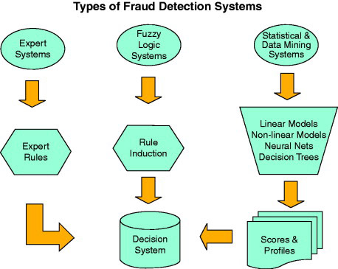
Types of fraud models

Slide 10
Types of Fraud Models
Early fraud models employed expert systems to detect fraudulent events. An expert system is a collection of expert opinions on a number of decision criteria. These systems induced rules from the responses of a group of experts in the field. These rules can be coordinated into a flow chart leading to a decision.
The problem with expert systems is that they are based on subjective inputs that may be contradictory
Subsequent fraud detection systems used automated rule induction engines, based decision tree technology, and fuzzy logic. Some of these fraud detection systems are still marketed today (iPrevent by Brighterion).

Slide 11
Types of Fraud Models
The Fair Isaac fraud detection systems Falcon Fraud Manager, eFalcon, and LiquidCredit Fraud Solution are built around a sophisticated system of predictive variables derived from extensive historical customer data.
These predictors have been selected by many years of modeling fraud in many companies. The variables are submitted to a powerful backpropagation neural net.

Slide 12
Fraud in Aspects of Business
Fraud can occur in many aspects of business, for e.g.:
Credit card fraud: Stealing or counterfeiting credit card numbers, or nonpayment of accounts
Application fraud: Untrue statements on a credit application, leading to assignment of an artificially low credit risk
Claim fraud: Submitting inflated or false claims
Life insurance: False or "engineered" death claims
Health care fraud: False billings by health care providers
etc.

Slide 13
Supervised Methods for Fraud Detection
Several elements are crucial to the successful supervised fraud model
The fraud event and the relationship of that event to specific transactions or responses of the fraudster must be accurately identified
Historical data of past transactions or responses must be available to derive powerfully predictive variables
Profiles of the past behavior and actions of both the fraudsters and the nonfraudsters must be built and employed in the modeling methodology
Predictive variables need to be identified for each type of fraud.

Slide 14
Detection of money laundering and other financial crimes
To detect money laundering and other financial crimes, it is necessary to integrate information from multiple databases such as bank transaction databases, and federal or state crime history
Multiple data analysis tools can then be used :
Data visualization tools to display transaction activities using graphs by time and by groups of customers
Linkage analysis tools to identify links among different customers and activities
Classification tools to filter unrelated attributes and rank the related ones
Clustering tools to group different cases
Outlier analysis tools to detect unusual amounts of fund transfers or other activities, and
Sequential pattern analysis tools to characterize unusual access sequences

Slide 15
Identifying Tax Fraud through Social Network Analysis
SNA(Social Network Analysis) is an analytic approach of correlating people, entities and relationships to determine how tightly an individual or business is related to others who have known compliance issues
These relationships can be from shared
phone numbers,
physical addresses,
bank accounts,
credit cards, or
any other connection
Graph analytics can give insights into members of the network
www.fico.com

Slide 16
Opportunities for Tax Agencies in SNA
Tax and revenue agencies to take advantage of SNA tools, across registration, audit and collections business areas
Improper registrations. A tax evader closes a business and the business re-opens (typically owned by a relative of the original owner) at the same or a nearby location. i.e. the owner stays in business by opening a similar (or identical) business with a different legal name and a different legal owner (e.g., a spouse, parent or another relative).
Very difficult to catch by manual efforts. The challenge for the tax agency is the owner will have changed and won’t be an exact match to the previous business.
www.fico.com

Slide 17
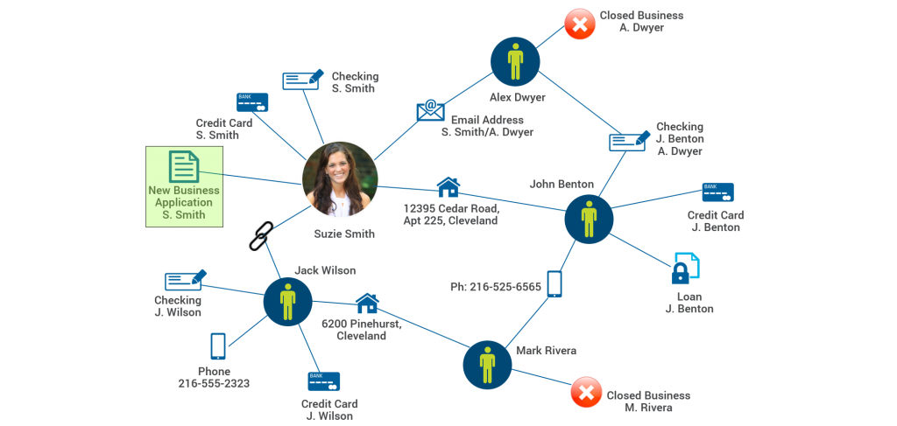
Opportunities for Tax Agencies in SNA
In the example, Suzie Smith has a direct relationship with one closed business and a second degree relationship with another closed business.
The state can deny the new registration or conduct additional investigations in a cost effective manner.
www.fico.com

Slide 18
Opportunities for Tax Agencies in SNA
Identify Fraud Rings. The SNA can identify related businesses. i.e. businesses with related addresses, bank accounts, phone numbers, email addresses, or other identifying characteristics.
SNA can help a revenue agent can identify additional individuals and/or businesses that may be related to the same fraud ring, saving the investigator time and effort.
Assisting with Locating a Delinquent Debtor. SNA’s are frequently used during the debt collection process to identify related individuals. SNA can greatly enhance and automate this effort, by finding people who share the same physical address, phone number, email, etc
Earlier collectors have utilized manual tools along these lines for years, contacting next-door neighbors (for example) in an attempt to locate a debtor.
www.fico.com

Slide 19
Opportunities for Tax Agencies in SNA
Finding Successor Businesses. When a business ceases operation, the business can re-open in a new location or under new ownership. If the original business owes money, the government can in many cases pursue that debt if there is a successor business
This can save the collector a significant amount of time for what otherwise would require significant manual research.
Tax agencies are data rich organizations, and analytics solutions like Social Network Analysis will allow them to identify more fraud and potential non-compliance situations well before a liability occurs
www.fico.com

Slide 20
RECOMMENDATION SYSTEMS
Recommender systems are an important class of machine learning algorithms that offer "relevant" suggestions to users. Categorized as either collaborative filtering or a content-based system, check out how these approaches work along with implementations to follow from example code.
How does YouTube know what videos you’ll watch? How does Google always seem to know what news you’ll read? They use a Machine Learning technique called Recommender Systems.

Slide 21
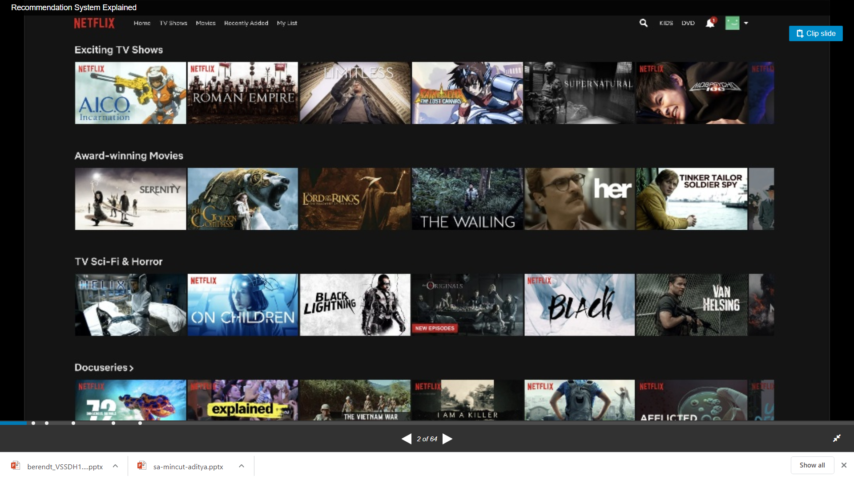
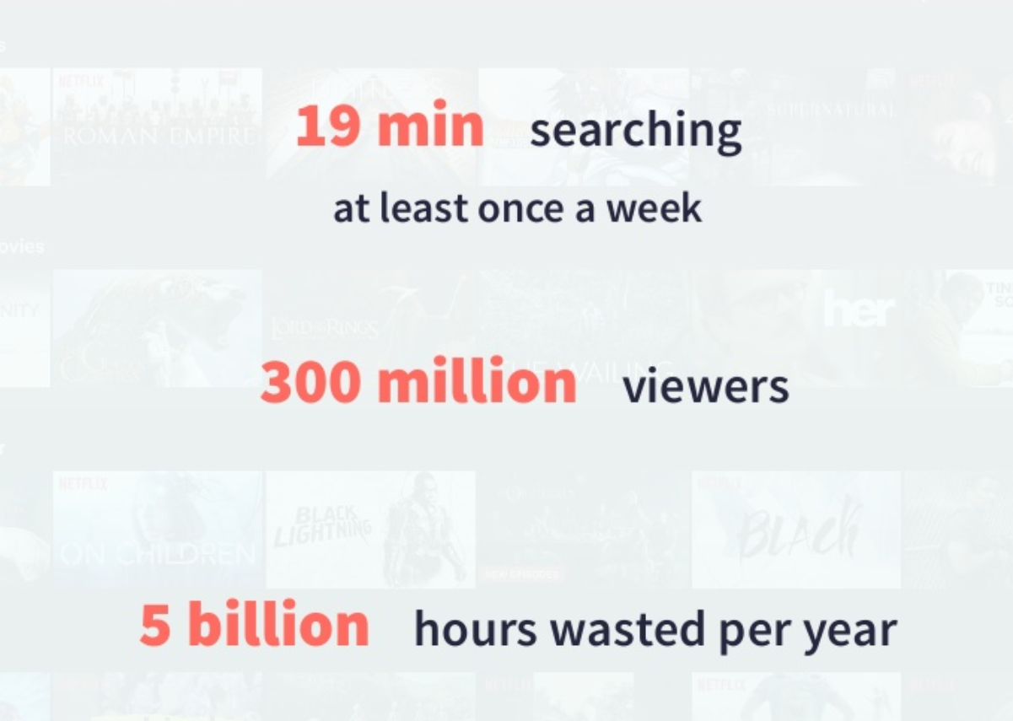

Slide 22
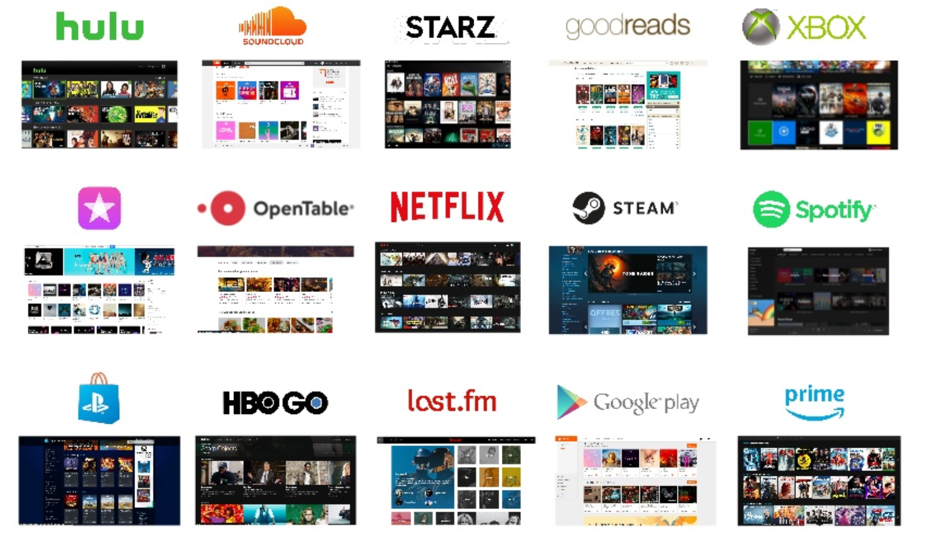

Slide 23
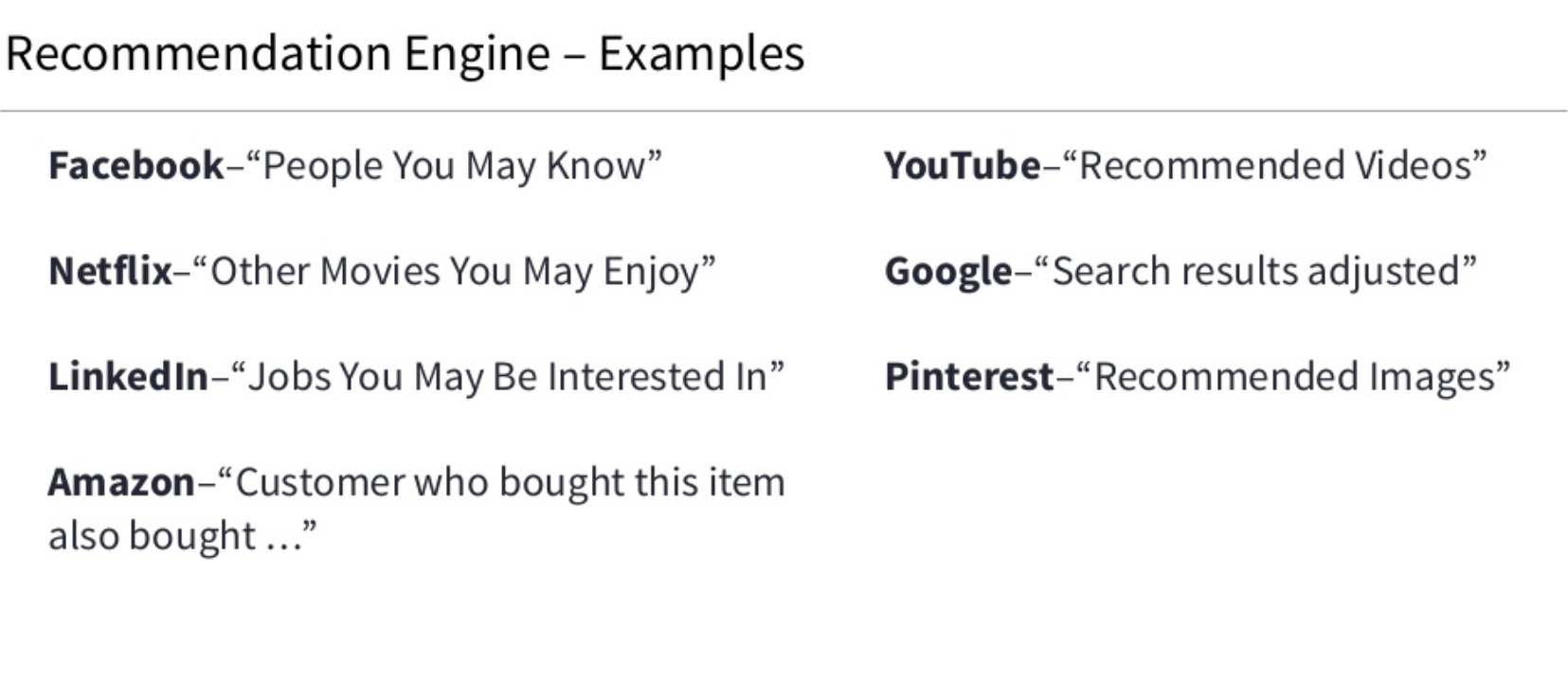

Slide 24
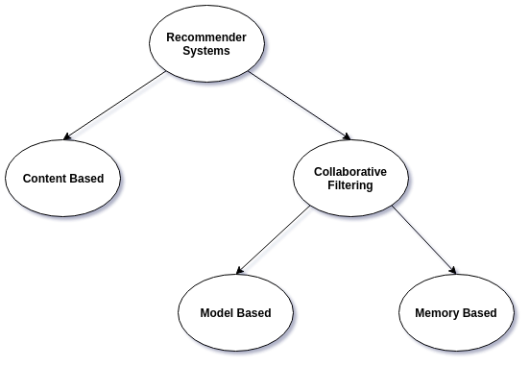

Slide 25
Collaborative filtering methods for recommender systems are methods that are solely based on the past interactions between users and the target items.
Thus, the input to a collaborative filtering system will be all historical data of user interactions with target items.
This data is typically stored in a matrix where the rows are the users, and the columns are the items.
The core idea behind such systems is that the historical data of the users should be enough to make a prediction.
We don’t need anything more than that historical data, no extra push from the user, no presently trending information, etc.

Slide 26
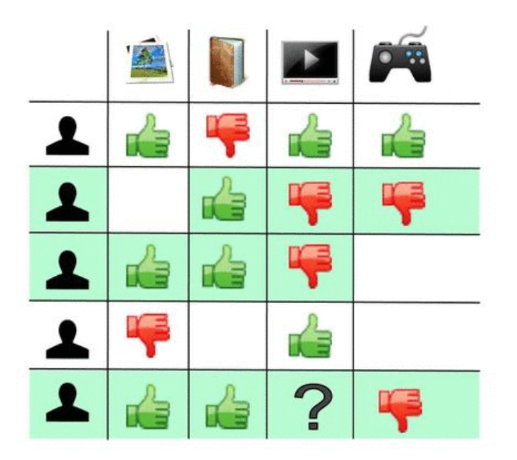
collaborative filtering works for predicting a user’s rating of 4 things: an image, a book, a video, and a video game. Based on the users' historical data, the likes and dislikes of each item, the system tries to predict how the user would rate a new item which they haven’t rated yet. The predictions themselves are based the past ratings of other users, whose ratings and therefore supposed preferences, are similar to the active user. In this case, the system made the prediction/recommendation that the active user won’t like the video.

Slide 27
Memory-based methods are the most simplistic as they use no model whatsoever. They assume that predictions can be made on pure “memory” of past data and usually just employ a simple distance-measurement approach, like nearest neighbour.
Model-based approaches, on the other hand, always assume some kind of underlying model and basically try to make sure that whatever predictions come out will fit the model well.

Slide 28

What is SENTIMENT ANALYSIS & OPINION MINING?
Identify the orientation of opinion in a piece of text
Can be generalized to a wider set of emotions
The movie
was fabulous!
The movie
stars Mr. X
The movie
was horrible!

Slide 29
Motivation
Knowing sentiment is a very natural ability of a human being.
Can a machine be trained to do it?
SA aims at getting sentiment-related knowledge especially from the huge amount of information on the internet
Can be generally used to understand opinion in a set of documents

Slide 30
Tripod of Sentiment Analysis
Cognitive Science
Sentiment Analysis
Machine Learning
Machine Learning
Natural Language Processing
Natural Language Processing

Slide 31
Sentiment Analysis
Monitoring what consumers are saying about a company's brands and products and how they are expressing their opinions and sentiments to others has always been important to businesses.
Until the last century, businesses typically used surveys and focus groups from time to time to gauge and track consumer sentiments.
With the widespread adoption of the Internet, the proliferation of social media channels (such as Twitter, Facebook, and others), and the abundant opportunity for consumers to express their opinions and sentiments, monitoring sentiment continuously has become more critical

Slide 32
Sentiment Analysis
"Conventional marketing wisdom long held that a dissatisfied customer tells ten people; but in the age of new social media, he or she has the tools to tell millions,"
Paul Gillin, author of The New Influencers: A Marketer's Guide to the New Social Media

Slide 33
Sentiment Analysis
The basic task involved in sentiment analysis is identifying and quantifying the polarity or valence of sentiments (such as positive, negative, neutral, or mixed) expressed typically in written opinions, expressions, reviews, comments, and so on
It involves many of the text analytics steps such as
tokenization,
sentence identification,
part-of-speech tagging,
and so on

Slide 34
Sentiment Analysis
Need to identify statements that convey sentiment
"It is an amazing TV“ – conveys sentiment
"Do not buy this TV" – conveys sentiment
"Which is the best TV?" – conveys no sentiment
Depending on the context, sentences can be non-comparative (where opinion is restricted to one thing) or comparative (where multiple things might be compared).

Slide 35
Example of a Review
Consider the following example of a review by a customer for a TV:
The TV is wonderful. Great size, great picture, easy interface It makes a cute little song when you boot it up and when you shut it off I just want to point out that the 43" does not in fact play videos from the USB This is really annoying because that was one of the major perks I wanted from a new TV Looking at the product description now. I realize that the feature list applies to the X758 series as a whole, and that each model's capabilities are listed below. Kind of a dumb oversight on my part, but it's equally stupid to put a description that does not apply on the listing for a very specific model

Slide 36
Granularity of Sentiment
Sentiment analysis starts with determining whether a text contains an opinion (sentiment). If it does contain sentiment, at what granularity level does the sentiment exist?
Document level: At this level, the task is to figure out whether the entire document can be classified as positive or negative
This is possible only if the document involves a single entity (such as the TV in the previous example).
Sentence level: At this level, the task is to classify each sentence in a document as a positive, negative, or mixed sentiment sentence.
In the previous example, the first sentence, expresses positive sentiment. The third statement, expresses negative sentiment

Slide 37
Granularity of Sentiment
Sentiment granularity can also be looked at from the object side:
Entity (or Object) and Attribute (or Aspect or Feature) level: An entity is typically the target of the opinion. However, in many sentences, the sentiments reflect the reviewer's opinions about attributes (or aspects or features) of the entity
"Great size, great picture, easy interface", express positive sentiment for three specific attributes “size, picture, and interface” of the entity, the TV

Slide 38
Challenges in Conducting Sentiment Analysis
Sentiment analysis starts with text data. So it has all of the typical natural language processing (NLP) problems associated with text analytics, viz.
identifying part-of-speech tags,
disambiguating terms and lexicons,
correcting spelling errors, etc.
Sentiment analysis needs to correctly identifying opinion words that express positive or negative sentiments.
There are opinion words whose polarity is always the same, e.g. the word "beautiful," always expresses a positive sentiment.
But, there are also context-dependent lexicons in which the polarity of the word depends on the domain or context, e.g. the word "small" can be positive or negative depending on the context. The sentence, "The size seems small." can be positive for a USB flash drive with 1 TB capacity. But, the same sentence can be interpreted as negative if the context is an LED big-screen TV.

Slide 39
Challenges in Conducting Sentiment Analysis
In addition to opinion words, there are idiom lexicons— e.g. "costs an arm and a leg" that embody sentiments.
In general, the difficulty with correctly identifying sentiments increases as you move from general to context-dependent to idiom lexicons in texts

Slide 40
Challenges in Conducting Sentiment Analysis
Further challenges in conducting sentiment analysis come from the nature of the text.
For example, tweets are short, and they are typically focused on one topic only. In that sense, they are easier to analyze. But, tweets often contain a lot of special meaning characters, such as RT (retweets), hashtags (#), emoticons (such as smiley faces), that need to be handled carefully.
Customer reviews are typically on one entity or object. Therefore, there is less ambiguity in the entity detection task when analyzing reviews.
Analysis of discussions, free-flow comments, and blog postings is often the hardest because they typically cover multiple entities, make comparisons instead of expressing direct opinions, use a lot of sarcasm, etc.

Slide 41
Unsupervised versus Supervised Sentiment Analysis
The sentiment analysis can be formulated as a supervised or an unsupervised mining problem, depending on whether there are known examples of documents belonging to positive or negative sentiments.
Unsupervised sentiment analysis involves the application of a sentiment lexicon of opinion-related positive or negative terms to evaluate text in the document.
Supervised approach involves machine-learning algorithms (such as support vector machines (SVMs) and neural networks) to textual feature representations to derive the relationships between features of the text segment and the opinions expressed in the document.
In many situations, known class examples are created by experts who read the documents or use rules, e.g. if a text review's numeric rating is four or more stars, then the review is positive.
If no known class examples are possible, then analysts have to use an unsupervised classification of sentiments.

Slide 42
Supervised Sentiment Analysis
Supervised classification is typically performed at the document level.
If enough labeled examples are available, commonly used classification models can be trained, validated, and tested to check their performances.
A good candidate is product review data, which typically has a text review and an overall numeric rating on a scale of one to five stars. Often, a review rating of four to five stars is considered a positive rating, and a review rating of one to two stars is considered a negative rating.
The main challenge for modelers is to select the inputs from text features such as terms and their frequencies (often weighted or normalized), part-of-speech tags, opinion lexicons (general, context-specific, and idiom), syntactic dependency (from parsing trees), and the handling of negation words (such as "not").

Slide 43
Unsupervised Sentiment Analysis
Unsupervised method is typically applied at the sentence level. There are two types of unsupervised methods: lexicon-based and syntactic-pattern based.
The lexicon-based approach can be used for sentence- and aspect-level sentiment classification. The relationships between opinion words and attributes are identified via dependency relationships obtained through parsing. For example, in the sentence, "The picture quality is outstanding," the opinion word "outstanding" and the attribute "picture quality" share the same dependency relationship with the verb "is."
If a clear dependency is not observed between an opinion word and an attribute, then how close an opinion word is to an attribute in a sentence can be used to judge the polarity of the attribute.
This process can get very complex, depending on how long the sentence is, how many attributes are being mentioned in the same sentence, whether both positive and negative polarity words are used in the same sentence, whether negation is used, and so on.
Once sentiment values are computed for each word-attribute combination, they are typically combined using appropriate normalization or weights to come up with an overall sentiment score.

Slide 44
Unsupervised Sentiment Analysis (Based on syntactic patterns)
Syntactic pattern-based approach involves defining part-of-speech tags and the keywords AND, NOR, OR, NOT, BUT, etc.
Primarily useful in contextual analysis when performing phrase -level analysis, this method can be used to develop a variety of rules for better accuracy.
For example, a simple pattern such as <subject> <NOT> <verb> can be used to extract negative phrases like, "This <feature> does <not> < work> as advertised."

Slide 45
3
Prescribed Text Books
 | Author(s), Title, Edition, Publishing House
 | Tutorial BB - Mining Twitter for Airline Consumer Sentiment Practical Text Mining and Statistical Analysis for Non-structured Text Data Applications by Gary Miner et al. Academic Press © 2012
 | Text Mining and Analysis: Practical Methods, Examples, and Case Studies Using SAS SAS Institute © 201

